Slide 1
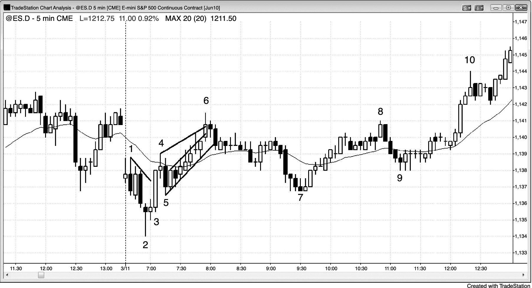
FIGURE 3.1 Breakouts, Trading Ranges, and Tests

